Slide 1
Understanding the problem decideability

Slide 2
Decidable Problems
A problem is decidable if we can construct a Turing machine which will halt in finite amount of time for every input and give answer as ‘yes’ or ‘no’. A decidable problem has an algorithm to determine the answer for a given input.
Examples
Equivalence of two regular languages: Given two regular languages, there is an algorithm and Turing machine to decide whether two regular languages are equal or not.
Finiteness of regular language: Given a regular language, there is an algorithm and Turing machine to decide whether regular language is finite or not.
Emptiness of context free language: Given a context free language, there is an algorithm whether CFL is empty or not.

Slide 3
Undecidable Problems
A problem is undecidable if there is no Turing machine which will always halt in finite amount of time to give answer as ‘yes’ or ‘no’. An undecidable problem has no algorithm to determine the answer for a given input.
Examples
Ambiguity of context-free languages: Given a context-free language, there is no Turing machine which will always halt in finite amount of time and give answer whether language is ambiguous or not.
Equivalence of two context-free languages: Given two context-free languages, there is no Turing machine which will always halt in finite amount of time and give answer whether two context free languages are equal or not.
Everything or completeness of CFG: Given a CFG and input alphabet, whether CFG will generate all possible strings of input alphabet (∑*)is undecidable.

Slide 4
Popular Undecidable Problems
Note: Two popular undecidable problems are halting problem of TM and PCP (Post Correspondence Problem). Semi-decidable Problems
A semi-decidable problem is subset of undecidable problems for which Turing machine will always halt in finite amount of time for answer as ‘yes’ and may or may not halt for answer as ‘no’.
Relationship between semi-decidable and decidable problem has been shown in Figure 1 as:

Slide 5
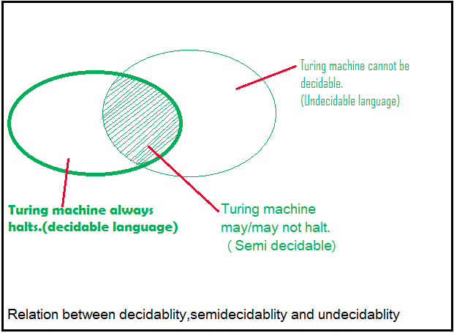

Slide 6
Post Correspondence Problem (PCP)
The Post Correspondence Problem (PCP), introduced by Emil Post in 1946, is an undecidable decision problem. The PCP problem over an alphabet ∑ is stated as follows −
Given the following two lists, M and N of non-empty strings over ∑ −
M = (x₁, x₂, x₃,………, x_{n})
N = (y₁, y₂, y₃,………, y_{n})
We can say that there is a Post Correspondence Solution, if for some i₁,i₂,………… i_{k}, where 1 ≤ i_{j} ≤ n, the condition x_{i1} …….x_{ik} = y_{i1} …….y_{ik} satisfies.

Slide 7
Example 1
Find whether the lists M = (abb, aa, aaa) and N = (bba, aaa, aa)
have a Post Correspondence Solution?
Solution
x1 x2 x3
M Abb aa aaa
N Bba aaa aa
Here,
x₂x₁x₃ = ‘aaabbaaa’
and y₂y₁y₃ = ‘aaabbaaa’
We can see that
x₂x₁x₃ = y₂y₁y₃
Hence, the solution is i = 2, j = 1, and k = 3.

Slide 8
Example 2
Find whether the lists M = (ab, bab, bbaaa) and N = (a, ba, bab) have a Post Correspondence Solution?
Solution:
x1 x2 x3
M ab bab bbaaa
N a ba bab
In this case, there is no solution because −
| x₂x₁x₃ | ≠ | y₂y₁y₃ | (Lengths are not same)
Hence, it can be said that this Post Correspondence Problem is undecidable.
Even 1,2,3 in any combination will not provide the same sequence for M and N. so it is undecidable.

